Slide 1
C Programming Language
December 5, 2014

Slide 2
Today’s task
Basic C Features
Basic types
Basic programming structure
Sequence
Branch
Loop
Array
C-style string

Slide 3
Basic types
int
float
double
char
4 Bytes
int a = 1
float pi = 3.14f
4 Bytes
double pi = 3.14159
8 Bytes
char c = ‘h’
1 Bytes

Slide 4
Type convert
int
float
double
Accuracy
double > float > int
int and char convert
Ascii table

Slide 5
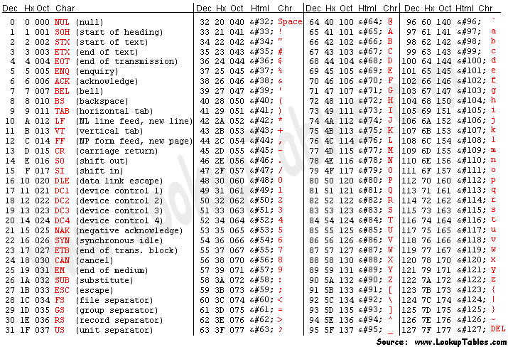

Slide 6
Three Basic program structure
sequence
branch
loop
int a = 1;
int b = 2;
int c = a +ｂ;

Slide 7
Branch if…else
int a=1;
if(a>0)
{
printf("positive");
}
else if(a < 0)
{
printf("negative")
}
else
{
printf("Zero")
}
int i=1;
if(a>0)
Y
printf(“positive ”);
N
else if(a<0)
Y
printf(“negative ”);
N
printf(“zero”)
Notes:
rhombus

Slide 8
Loop
Perform a set of repetitive task until text expression becomes false
while
do…while
for
calculate 1+2+3+…+100

Slide 9
Loop while
i=1;
sum=0;
int i = 0;
int sum = 0;
while(i<=100)
{
sum += i;
i += 1
}
i<=100
Y
sum += i;
i += 1

Slide 10
Loop do while
i=1;
sum=0;
int i = 0;
int sum = 0;
do
{
sum += i;
i += 1;
} while (i<=100);
sum += i;
i += 1
i<=100
Y

Slide 11
Loop for
for (int i=0;i<=100;i++)
{
sum += i;
}

Slide 12
When should we use while, do while and for?
most loops can be written in all three ways
while
check the expression first and do jobs
do…while:
do jobs first and then check the expression
for
if you know the loop times exactly, use for
code is short

Slide 13
Break and continue
Break: stop the loop
Continue: only skip this time

Slide 14
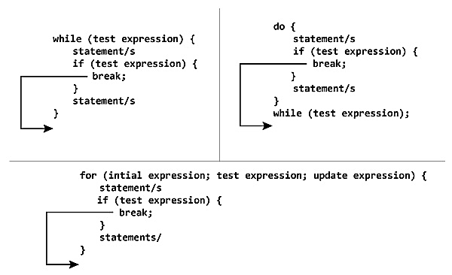

Slide 15
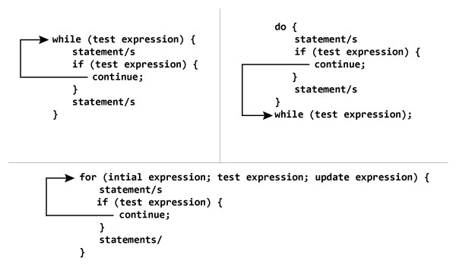

Slide 16
function
Code that we need to use more than once
int mul(int x, int y)
{
return x * y;
}

Slide 17
Pass parameter by value or by address
int self_add1(int x)
{
x = x + 1;
return x;
}
int self_add2(int *x)
{
*x = *x + 1;
return *x;
}
printf("%d\t%d",self_add1(x),x);
printf("%d\t%d",self_add2(&x),x);

Slide 18
A little challenge
Write a little program that users can type an expression and the program will return the result
e.g.
if users type 1 + 2 and press enter
the program will display 3 on the screen

Slide 19
Array declare
int lst1[] = {0,1,2,3,4,5,6,7,8,9};
int lst2[10];
int lst3[10] = {0,1,2,3,4,5,6,7,8,9};
int twodim[10][10];
int threedim[10][10][10];

Slide 20
Array modify and use
modify and access an element with index
index range: 0~n-1
int lst[10];
lst[3] = 4; // ok
lst[10] = 1; // wrong

Slide 21
Array and pointer
int lst[10];
lst stores the address of the first element of the array
What’s the difference between array and pointer?
The address stored in the lst is unable to modify, but the store stored in a pointer is ok to modify

Slide 22
Disadvantage of array
The size of array is set previously and unable to modify

Slide 23
C-style Strings
what is a string?
“Hello, world!”
An array of char
Declaration
char astring[50];
char *pstring[50];
pstring = (char*) malloc(sizeof(char) * 50);
//...
free(pstring);

Slide 24
fgets function
char string[256];
printf( "Please enter a long string: " );
/* notice stdin being passed in */
fgets ( string, 256, stdin );
printf( "You entered a very long string, %s", string );

Slide 25
string manipulate function <string.h>
stsrcmp: string compare
strcat: string concatenate
strlen: length of a string

Slide 26
Homework
implement your own string manipulate function including
strlen
strcmp
strcat

